Slide 1
Azure Administration

Slide 2
Cloud Computing
On Demand
Scalable
High Availability
Pay-As-You-Go
Elasticity
Disaster Recovery
Fault Tolerance
Reliability
Security

Slide 3





Slide 4
Azure Portal
Let’s you build, manage and monitor everything from simple web apps more complex cloud applications in a single, unified console.
Search resources, services and docs
Manage Resources
Create customized dashboards and favourites
Access the cloud shell
Receive notification
Links to Azure documentation

Slide 5
Azure Mobile App
Helps you keep track of your resources while on-the-go
Stay connected to the cloud
Diagnose and fix issues
Run commands to manage your Azure resources

Slide 6
Azure Cloud Shell
Interactive, browser accessible shell for managing Azure resources.

Slide 7
Azure CLI
https://docs.microsoft.com/en-in/cli/azure/install-azure-cli
https://docs.microsoft.com/en-in/cli/azure/reference-index?view=azure-cli-latest

Slide 8
Azure PowerShell
https://docs.microsoft.com/en-in/powershell/azure/install-az-ps?view=azps-8.1.0
https://docs.microsoft.com/en-in/powershell/module/az.accounts/?view=azps-8.1.0#accounts

Slide 9
Resource Manager

Slide 10
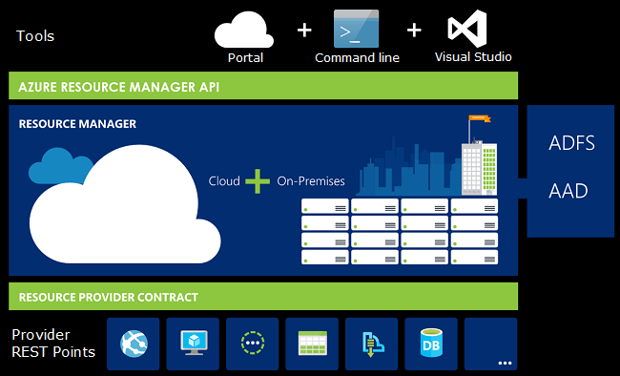


Slide 11
Terminologies
Resource – Manageable item – Virtual Machine, Storage Account, Web App, Database and Virtual Network
Resource Group – A container that holds related resources for an Azure solution.

Slide 12




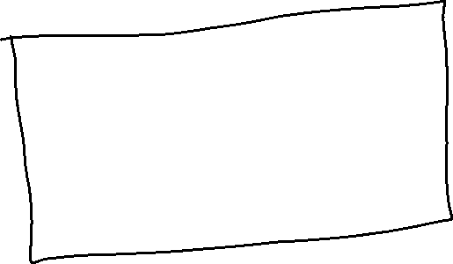










Slide 13
Resource Group
Resource Groups are at simplest logical collection of resources.
Resources can only exist in one resource group
Resource Groups cannot be renamed
Resource Groups can have resources of many different types
Resource Groups can have resources from many different region

Slide 14
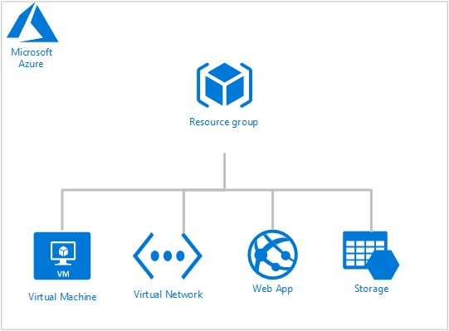




Slide 15
Resource Group
Creation
Add a Resource
Move Resource - https://docs.microsoft.com/en-us/azure/azure-resource-manager/management/move-support-resources
Deletion

Slide 16
Resource Locks
Read-only lock – Prevent any changes to the resource
Delete lock – Prevent deletion

